Slide 1

IOT BASED SMART WASTE MANAGEMENT SYSTEM
GUIDE NAME TEAM MEMBERS DR.GAURAV DUBEY KARAN AGARWAL(2000290120082)
(PROFESSOR) HARSH YADAV(2000290120073)
KARNIK GAUTAM(2000290120083)

Slide 2
Introduction
Smart waste management is an innovative approach to handling and collecting waste . Based on IoT (Internet of Things)technology, smart waste management provides data on waste generation patterns and behavior. This empowers municipalities, cities, and waste collectors to optimize theirwaste operations, become more sustainable, and make more intelligentbusiness decisions.
An android or web app is developed for the work force and the citizens, which primarily provides the pop ups message to all municipality employee regarding in this location and our dustbin is completely full no more space in that you have to empty it

Slide 3
PROBLEM STATEMENT
Nowadays, as we seen that dustbins are being overflowed and they are not being monitored properly.
This will result in serious health issues and also affecting the surrounding environment.
The Collectors are also unable to find out the overflowed dustbins and hence it hampers their work.
As a result, people tend to throw garbage in nearby surroundings and it will create a pollution in the environment.

Slide 4
Objective
Garbage management system is a idea where we can control lots of problems which disturbs the society in pollution and diseases. The garbage management has to be done instantly else it leads to irregular management which will have adverse effect on nature.
The main objectives of our proposed system are as follows:
Monitoring the garbage management.
Providing a smart technology for garbage system.
Reducing human time and effort .
Resulting in healthy and waste ridden environment.

Slide 5
Comparison between existing system and proposed system
EXISTING SYSTEM
PROPOSED SYSTEM
Employees heading for their workstations every morning. For all those people, there are just not enough garbage bins available
The obvious solution to this is for the cleaning staff to stay near garbage bins every day till they fill up to clean them. This is not a real solution.
There are some notable negative effects when considering the garbage bins always being full. One of the main effects is the surrounding area starting to smell and be very unpleasant. When the garbage bins are full people put their trash on sides of the garbage bins.
The proposed system overview for this system. Solid waste management can be broadly categorized as segregation, collection, and transportation.
The server will collect the data and store them only a database. This data will be analyzed and displayed on two different dashboards that can be accessed by the workforce and clients.
Based on the data collected, garbage trucks can be given routes generated through various algorithms and Google maps API to efficiently route through all necessary garbage bins and finally reach the dumping site

Slide 6
TECHNOLOGIES USED
FRONT END : HTML , CSS, JAVASCRIPT
BACKEND : REACT JS, PHP, MYSQL
TOOLS : ANDROID STUDIO
IOT : ULTRASONIC SENSOR, NODE MCU ESP8266 WIFI MODULE

Slide 7
METHODOLOGY
Firstly, we will collect data using Ultrasonic sensor and then data is sent to admin.
The collected data is further processed and the dustbins which are full are being filtered.
The data of these filtered dustbin is further propagated to nearest garbage collector .
The collector on receiving this dustbin data will empty the designated dustbin and sensor will automatically update the status of emptied dustbin on the app .

Slide 8
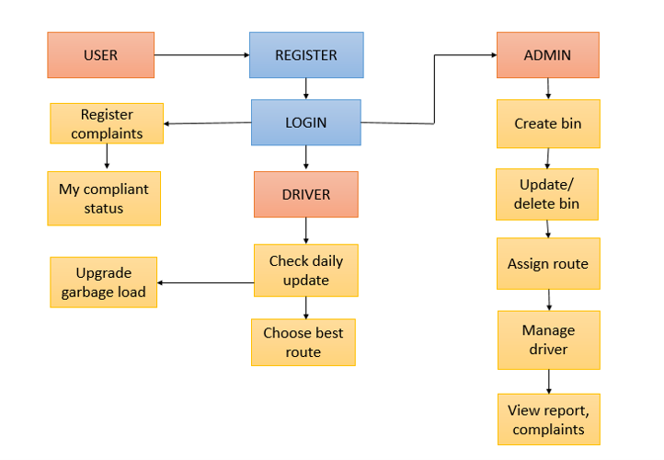
Architecture Diagram

Slide 9
Advantages
Real time information on the fill level of the dustbin.
Deployment of dustbin based on the actual needs.
Cost Reduction and resource optimization.
Improves Environment quality.
Intelligent management of the services in the city.

Slide 10
CONCLUSION
We have developed the cost-effective waste management system. Smart garbage management systems like these will go a long way in making our daily lives much healthier and toxic free.
Also, it can contribute to reducing fuel consumption of the garbage trucks by going for collection to particular areas only when the considerable amount of the cans is present in that particular geographic location that needs to be collected.
Since its requirement for funds is less, this system can become readily available in all countries that aren't looking forward to investing much in their garbage department.

Slide 11
Future Enhancement
In Future ,one area that can be improved on, but limited at this time due to trying to making this project low cost, is identifying types of garbage from the bin itself, thus removing human segregation.
If this is implemented, in a single location instead of four bins for the four different types of garbage, one large bin can be placed which segments the garbage by itself.
.

Slide 12
THANK
YOU

